Slide 1

Introduction to Computer Science: Programming Methodology
Tutorial 1
Introduction
Junpeng Zhang, SSE
2023

Slide 2
Outline
Teaching fellows
Schedule for tutorials
Install Python
About assignments and exams
Some tips
An example

Slide 3
Teaching fellows
Instructors:
Prof HAN, Xiaoguang (L02)
Prof ZHAO Junhua(L03 / L04)
Prof SUN Qilin(L05)
Prof HE Pinjia (L06)

Slide 4
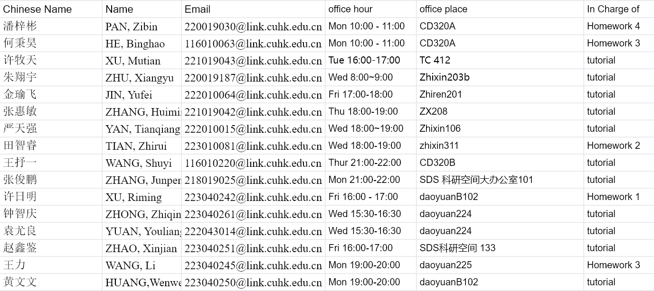
Teaching fellows
Office Hour of TAs:

Slide 5
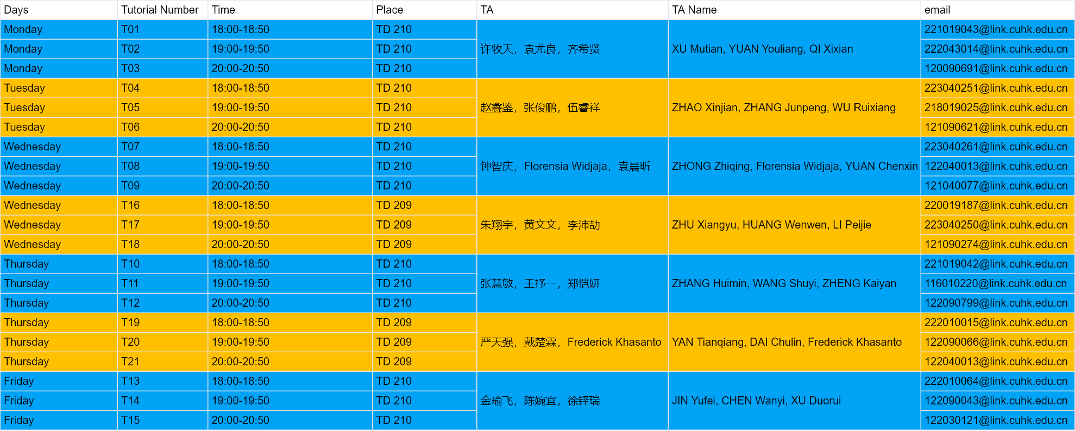
Timetable
Arrangement of Tutorials:
The materials of tutorials can be downloaded from Onedrive, the link can be seen in the blackboard.

Slide 6
Survey: How many of you have learned programming before?

Slide 7
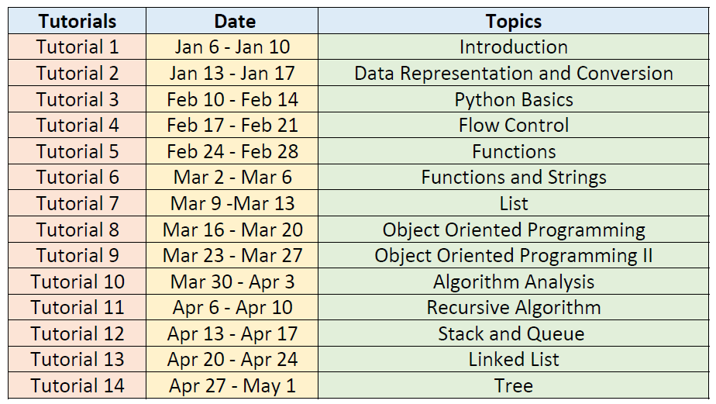
Schedule

Slide 8
What we do in tutorials?
Writing python codes to solve problems. Around 3~6 problems in one tutorial.
TAs may explain the algorithms and python codes, or discuss and answer some questions from students about the lectures.

Slide 9
What is the computer programming?
Computer programming is the process that professionals use to write code that instructs how a computer, application or software program performs.
Code → Programs → Software / websites / apps …
What job can we take after learning computer programming?

Slide 10
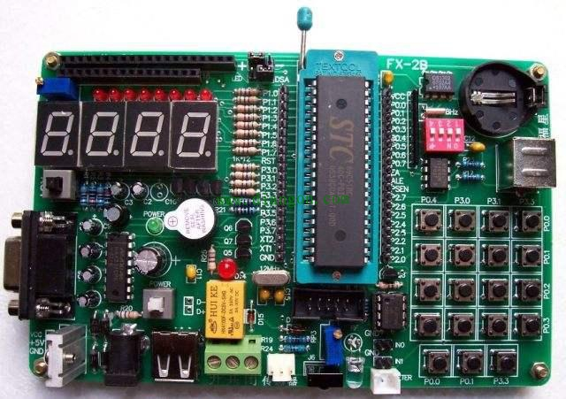
Why we choose to learn Python?
What is the computer programming language?
Your code→ … → Machine instructions → Action.
For example, suppose 00000000 represents “turn off all bulbs”.
So, why do we choose to learn Python?

Slide 11
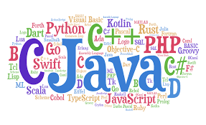

Slide 12
Low Level Language and High Level Language.
Assembly language is a low level language. It’s very difficult to use.
C, C++, Python, Java, C#… are high level language.
Executing efficiency VS coding efficiency.
However, …
Learning Python in this term helps you open a gate to the programming world. So grasp this opportunity!

Slide 13
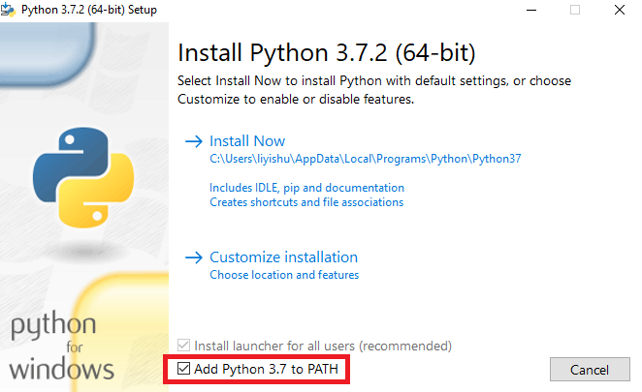
Installation Steps
Download stable version (3.8) from https://www.python.org/
Do remember to download the correct version for your own platform (Windows/Linux/MacOS)
Install step by step.
Make sure you’ve added Python path to environment variables.
Some students prefer using “PyCharm”, having more functionalities. You could google or baidu to download and install it.

Slide 14
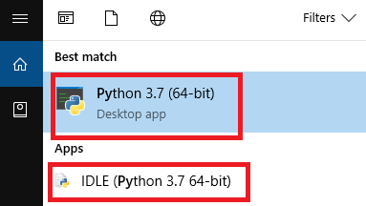
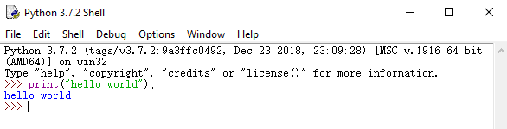
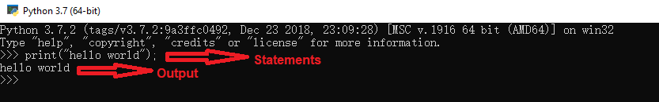
How to write and run the program
Search “python” in start menu (Windows)
Open Python desktop app or IDLE.
You can write your code statement under shell (e.g. type “print(“hello world”);”
Press enter and then the code will be executed. (“hello world” will be printed)

Slide 15
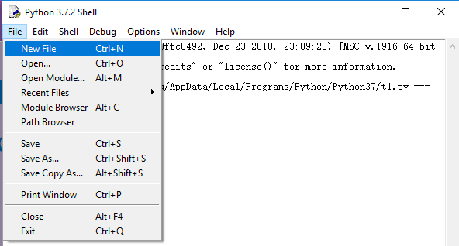
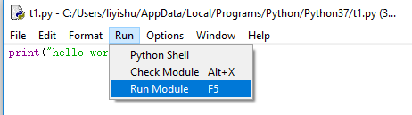
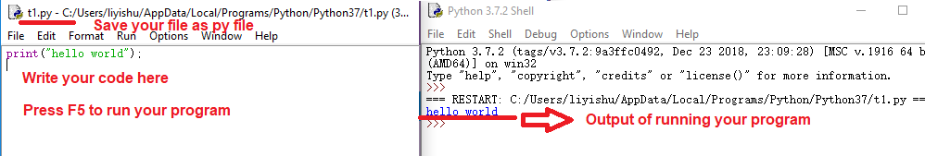
How to write and run the program
In IDLE, you can also open or new a py file. Write your code in this file, and then press “F5” (or “Run” -> “Run Module”) to run your program.

Slide 16
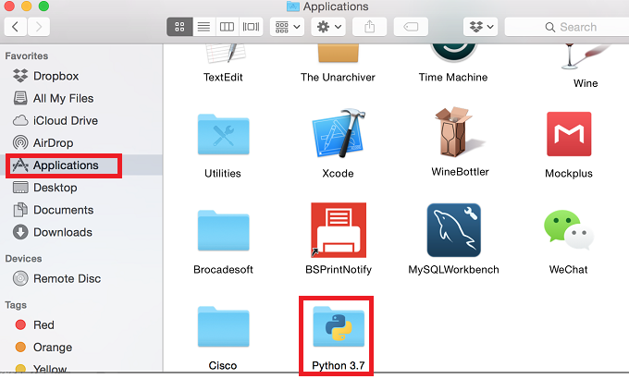
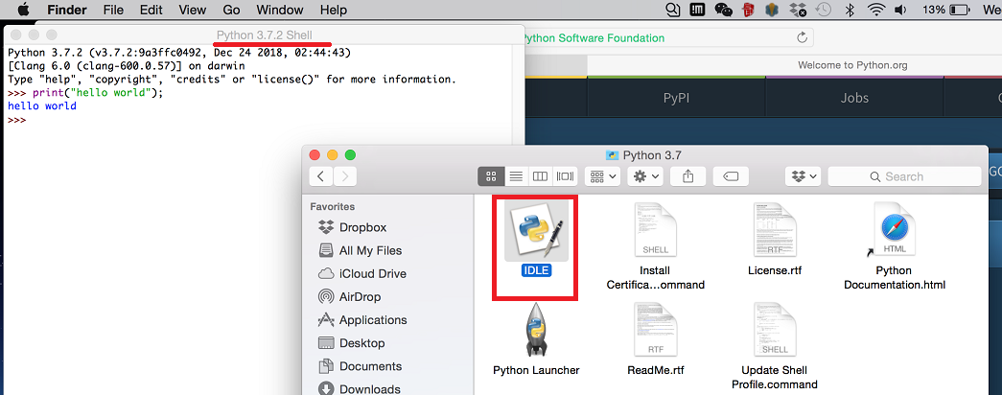
How to write and run the program
For MacOS, you will find a folder named “Python 3.7” being displayed under Application.
Double click “IDLE” and you will see the Shell and can write your py file or write your code in shell directly.

Slide 17
A better software…
Rather than utilize idle, I recommend you to download Anaconda, the “spyder” ide from it is very useful.
IDEs help you manage your program projects.
Some famous IDEs: Spyder, Pycharm, Vscode, …
Show time…

Slide 18
knowledge points of Python
identifier
basic grammars
variables’ type
operator
conditional statement, loop statement
string
list, tuple, dictionary
function

Slide 19
knowledge points of Python
module
file, I/O
OOP: Object-oriented Programming

Slide 20
Key point
In order to improve your programming skill, you must try your best to write more code.
Write comments when coding. The volume of comments need to cover over 1/3 of your codes.

Slide 21
About assignments and exams
Assignments are about writing codes to solve problems, codes (.py) and explanations(.pdf) about your programs(zipped into one file) are supposed to be uploaded to the blackboard system before the deadline and Named the files correctly.
Passing deadline will deduct some points, three days after deadline won’t be accepted.
Exams are paper forms, about understanding the lecture notes and writing codes on exam papers.

Slide 22
Some tips
Learn based on lecture notes. Practice, practice and practice.
Programs are to help you solve problems, but it is still you to solve the problems, computer is just to calculate faster. So you should solve the problems by yourself first for the simpler cases, then design algorithms to let computer do it.
Before midterm: basic tools(data types, if else, for, while) to solve problems, similar to a designed calculator.
After midterm: abstract concepts(functions, class, algorithm, list, tree etc.), to combine tools into a “machine” with functionalities.

Slide 23
An example: get email addresses
Problem: Once I need to send an email to a large amount of students, but I only get a file with their student ids. How can I get a file with their email addresses.
Solution: To solve it, just import the id file and add “@link.cuhk.edu.cn” after that, and write into a new file.

Slide 24
An example: get email addresses
Tips for writing codes:
Use words to represent variables in order to remember their meanings easily;
Write comments using “#”to explain important parts of your algorithm.

Slide 25
Announcement
Remember to bring your laptop next time!

Slide 26
Any questions or suggestions?

